Slide 1
Linear Regression and classification
Subject: Introduction to Artificial Intelligence and its Applications Code: 19EAI232
Registration Number: 122010324035 Name: G Naga Sai Saran
Registration Number: 122010325012 Name: Jaswanth Sunkara
Registration Number: 122010325002 Name: Polasa Rahul
Semester: IV - Session May 2022

Slide 2
Classification
Classification is the process of predicting a label for given data points.
Classification predictive modelling is the task of approximating a mapping function (f) from input variables (X) to discrete output variables (y).
For example, spam detection in email service providers can be identified as a classification problem. This is a binary classification since there are only 2 classes as spam and not spam.
A classifier utilizes some training data to understand how given input variables relate to the class or category.
In this case, known spam and non-spam emails have to be used as the training data. When the classifier is trained accurately, it can be used to detect an unknown email.
Some applications of classification are credit approval, medical diagnosis, target marketing etc.

Slide 3
Linear Regression
Linear Regression is a machine learning algorithm based on supervised learning.
Regression models a target prediction value based on independent variables.
It is mostly used for finding out the relationship between variables and forecasting.
Different regression models differ based on – the kind of relationship between dependent and independent variables they are considering, and the number of independent variables getting used.

Slide 4
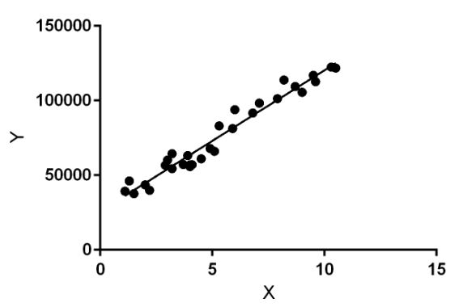
Linear regression performs the task to predict a dependent variable value (y) based on a given independent variable (x).
So, this regression technique finds out a linear relationship between x (input) and y(output). Hence, the name is Linear Regression. In the figure below, X (input) is the work experience and Y (output) is the salary of a person. The regression line is the best fit line for our model.

Slide 5
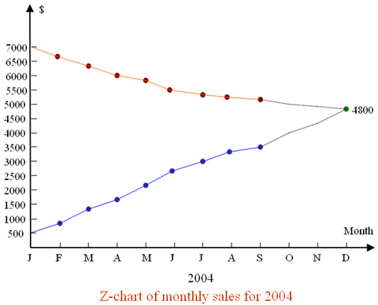
Applications
If a company, wants to know if the funds that they have invested in marketing a particular brand has given them substantial return on investment, they can use linear regression.
Predicting crop yields based on the amount of rainfall-Yield is a dependent variable while the measure of precipitation is an independent variable.

Slide 6
conclusion
In conclusion, to put simply we can say that classification is useful where we need to sort out data into their respective categories or classes like labelling cats and dogs images correctly.
To find out a linear relation between a dependent variable like an umbrella sales and some independent variables like rainfall, is where linear regression comes into picture.

Slide 7
References
https://www.quora.com/What-are-the-best-applications-of-linear-regression
https://www.analyticssteps.com/blogs/7-types-regression-technique-you-should-know-machine-learning
https://www.analyticssteps.com/blogs/simple-linear-regression-applications-limitations-examples
https://hbr.org/2015/11/a-refresher-on-regression-analysis

Slide 8
THANK YOU

